Slide 1
Cloud Technology’s Risk Assessment
Murt Sayeed CSO 116 Spring 2021 Tufts University

Slide 2
Agenda
Introduction
Background
To the Community
Discussion
1. Cloud Services – Associated Risks
1.1 Infrastructure as a Service (IaaS)
1.2 Platform as a Service (PaaS)
1.3 Software as a Service (SaaS)
2. Web-based Applications – Vulnerabilities and Information Hijacking
Action Items For Us
1. Cloud Services – Mitigation of Risks
2. Web-based Applications – Mitigation of Risks
Conclusion
References

Slide 3
Introduction
Cloud industry has become significantly huge in last two decades
Concept behind cloud is any computing or storage power on an off-site hosted location
Enables on-demand computational
Storage resources with lower economic benefits with effective way to help manage capital expenditure and operational cost
Offer flexibility, pay-per use preferences, low cost, and are highly automated
*** Security is still an important risk****
Examples: self-driving vehicles or grocery shopping at Wholefoods
Multi-billion dollars company delivering products and services to clients
Strategizing your internal processes
University student trying to utilize cloud for everyday storage of your academic assignments
Not everyone realizes its risk and security measures
Increased crime in cybersecurity in the internet space

Slide 4
Reference
Notes:
https://www.flexera.com/blog/cloud/cloud-computing-trends-2021-state-of-the-cloud-report/

Slide 5
GOAL: Security risk must be on the forefront of everything

Slide 6
Background Information
We must understand what it means to store your information remotely.
Many components of cloud
Client Infrastructure
Application
Service
Runtime Cloud
Storage
Infrastructure
Management
Security
Internet
Notes:
https://www.upgrad.com/blog/components-of-cloud-computing-architecture/

Slide 7
To the Community
Cloud is the future of technology
Over 90% of enterprises in US using cloud and spending millions of dollars every year
We MUST understand its vulnerabilities
Apple company has around 850 million iCloud users as of 2021, with 150 millions of them paid users
Cloud is touching the lives of many people and we must evaluate its risky nature

Slide 8
Discussion
1. Cloud Services – Associated Risks
1.1 Infrastructure as a Service IaaS
1.2 Platform as a Service PaaS
1.3 Software as a Service SaaS
2. Web-based Applications – Vulnerabilities and Information Hijacking

Slide 9
1. Cloud Services – Associated Risks
Every services will come with some risk and challenges
Top three cloud delivery models are:
Infrastructure-as-a-service (IaaS)
Platform-as-a-service (PaaS)
Software-as-a-service (SaaS)

Slide 10
Reference
Notes:
https://www.bigcommerce.com/blog/saas-vs-paas-vs-iaas/#the-key-differences-between-on-premise-saas-paas-iaas

Slide 11
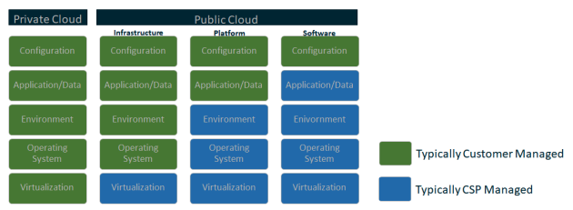
Reference
Notes:
https://media.defense.gov/2020/Jan/22/2002237484/-1/-1/0/CSI-MITIGATING-CLOUD-VULNERABILITIES_20200121.PDF

Slide 12
1.1 Infrastructure as a Service IaaS
This service has virtual machines for many needs
Data storage, servers, networking capabilities and computing power
The cloud service provider is managing real estate space and hardware to run these giant machines
Responsible for security of such machines used by us and millions of other clients
You are only responsible for the billed being paid on such service by utilizing computing and consumption.

Slide 13
1.1 Infrastructure as a Service IaaS - Risk
IaaS can have security breaches that can be risky for you
Security challenges on IaaS isn’t under your prevue but you may still be the one affected here
Some of the security risk that are under our control can be a huge life saver when it comes to exposing customer’s information or dealing with regulatory committees
Fraudsters can utilize points of vulnerability to their advantage.
Staff must configure IaaS accurately with proper security standards to avoid unauthorized access
Cloud service provider- there must be a full control in place on the server physical environment
Authentication to anyone one person, whether its maintenance or operational staff
As a client, you have to access IaaS among many data centers that can cause additional firewall and routing rules on internet traffic, meaning more points to breach security.

Slide 14
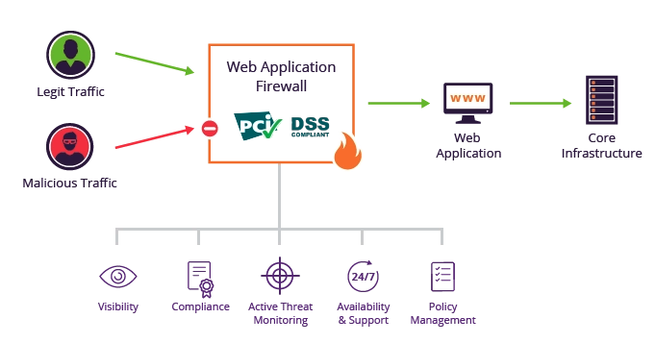
Firewall Example
Reference
Notes:
https://www.imperva.com/learn/application-security/application-security/

Slide 15
1.2 Platform as a Service PaaS
Capability to build software on a cloud based platform
The cloud service provider gives framework to us and we manage such software applications
while cloud service provider manages servers, storage and networking
There is a possibility that our platform and what have we built on it may not work if the cloud services provided to us are rendered unexpectedly

Slide 16
1.2 Platform as a Service PaaS - Risk
One of the major security risk here is not having proper permissions to data
Due to many information leakage in the industry, and permissions to access information easily for fraudster were the most common
Another way for security disaster to happen is using default configurations at the time of initial setup
Major threat to PaaS is SSL based attacks
spoofing SSL certificate
a monkey in the middle (MIM)
The ability of networks to communicate confidentially and still have access remotely is another security risk one has to consider under PaaS
The major access control items here are authentication, authorization and traceability, where fraudsters may impersonate, do phishing attacks, do brute force attacks and/or password reset attacks

Slide 17
1.3 Software as a Service SaaS
Most common in the marketplace that offers ready-run software application
Everything else from infrastructure operations to software maintenance of managing, updating and securing are handled by cloud service provider
application is run through client’s browser with no download or installations

Slide 18
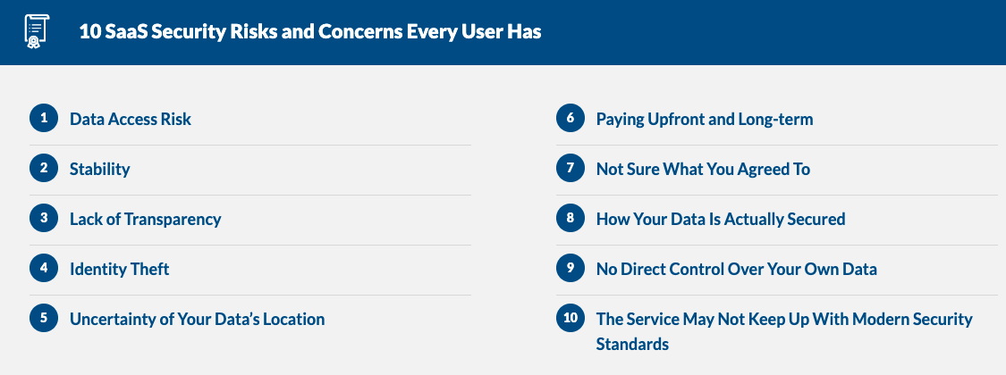
1.3 Software as a Service SaaS
Reference
Notes:
https://financesonline.com/10-saas-security-risks-concerns-every-user/

Slide 19
1.3 Software as a Service SaaS - Risk
Many risk factors have also exponentially increased
Phishing is still a concept where over 90% of cyber-attacks happen due to it
Fraudster can also do account take over with the help of employee’s credentials
by some phishing campaign or buy it on dark web via data leaks
Humans are accustom to negligence
weak passwords or lost laptop, fraudster can exfiltrate and abuse SaaS information without our knowledge
Fraudsters have also increased their zero-day malware activities
it’s hard for us to identify and a simple auto ‘sync’ feature on the application could amplify the security threat

Slide 20
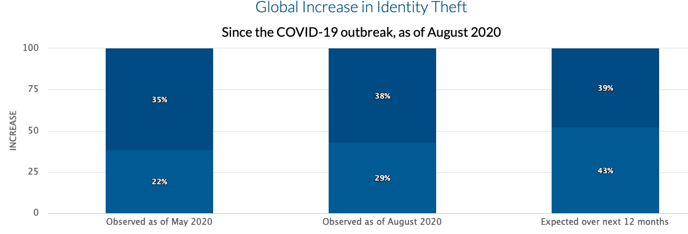
1.3 Software as a Service SaaS - Risk
Reference
Notes:
https://financesonline.com/10-saas-security-risks-concerns-every-user/

Slide 21
2. Web-based Applications – Vulnerabilities and Information Hijacking
Are there any vulnerabilities to accessing cloud via web-based applications and who’s responsible for information hijacking?
Examples: email to our banking needs
Information hijacking
Fraudster could steal session ID
Access point
Scanning - Sniff attack - Brute force attack
Spoofed MAC address

Slide 22
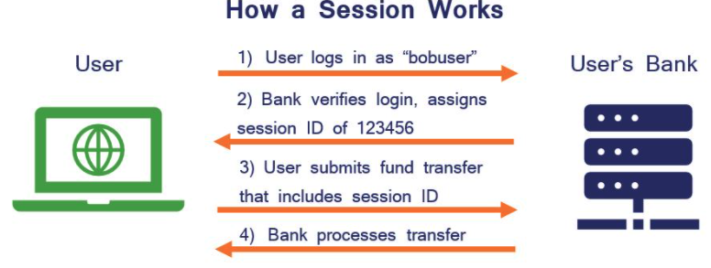
Reference
Notes:
https://securityboulevard.com/2020/11/the-ultimate-guide-to-session-hijacking-aka-cookie-hijacking/#:~:text=What%20is%20Session%20Hijacking%3F,re%20logged%20in%20and%20authenticated.

Slide 23
Action Items For Us:
1. Cloud Services – Mitigation of Risks
2. Web-based Applications – Mitigation of Risks

Slide 24
1. Cloud Services – Mitigation of Risks
Most responsibilities regarding cloud security fall under cloud service provider
The client loses access to the hardware hosting its information and stolen information
Cloud providers should be responsible to vet its employees while client information and customers are at risk
Client is responsible for correct utilization of API where cloud provider is responsible that its secure
Due to lack of legislative policies in cloud industry, we as clients must develop our own top-notch security policies

Slide 25
1. Cloud Services – Mitigation of Risks
IaaS
IaaS is definitely a great tool to have for a company but has security risks
Take AI-powered take advantage of cloud security and reduce false positives in regards to dangerous malicious attacks
For example, an employee getting access to the server on Starbucks public WIFI might look suspicious with via VPN

Slide 26
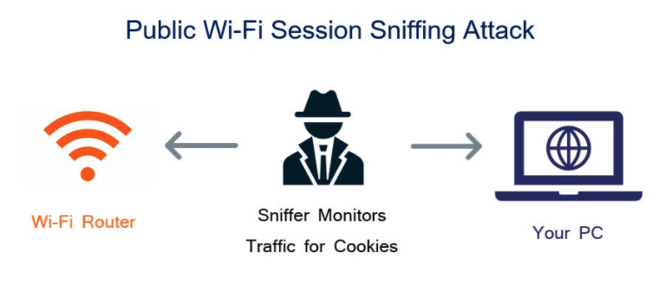
Reference
Notes:
https://securityboulevard.com/2020/11/the-ultimate-guide-to-session-hijacking-aka-cookie-hijacking/#:~:text=What%20is%20Session%20Hijacking%3F,re%20logged%20in%20and%20authenticated.

Slide 27
1. Cloud Services – Mitigation of Risks
PaaS
PaaS security concerns have two things:
design application with security in mind from the start
all application users must authenticate before using
Company is able to apply information protection strategies and can only give limited access based on application usage
The 2-factor authentication in smart cards and biometric mechanisms can help protect the information from fraudsters
Correct provider based configuration, as Microsoft Azure may have different patches compare to AWS.

Slide 28
1. Cloud Services – Mitigation of Risks
SaaS
The spike in SaaS usage around the industry and continuous technological advances have made this cloud service very receptive to security risks
For larger companies, we have Cloud Access Security Brokers (CASB) as a solution providing visibility
access control and data protection using a gateway, proxy or APIs
Smaller companies can use SonicWall Cloud App Security (CAS) to help with data protection for SaaS applications
Additional services can help with security and protect against phishing attacks, email compromise, zero-day threats, data loss and account takeovers
Company’s SaaS landscape and implement robust polices across all cloud services.

Slide 29
2. Web-based Applications – Mitigation of Risks
For basic security measure, each cloud based web application must have authentications
When there is breach somewhere, we must notify all users who owned such information and what’s has been compromised
We could look at MAC sequence numbers and packet sniffers to check for ARP updates
Combination of HTTP and SSL protocol layers is called HTTPS can help encrypt communication
Another way is One-Time Cookies OTC where fraudsters cannot brute force an attack
Protect against Cross-site scripting (XSS)
XSS is a pretty common practice for a fraudster to hijack a web session by inserting malicious coding
Secure private network
Everybody knows that public network such as airport or Starbucks are prone to vulnerabilities

Slide 30
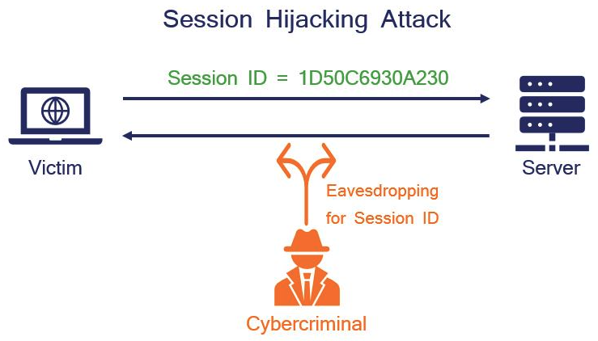
Reference
Notes:
https://securityboulevard.com/2020/11/the-ultimate-guide-to-session-hijacking-aka-cookie-hijacking/#:~:text=What%20is%20Session%20Hijacking%3F,re%20logged%20in%20and%20authenticated.

Slide 31
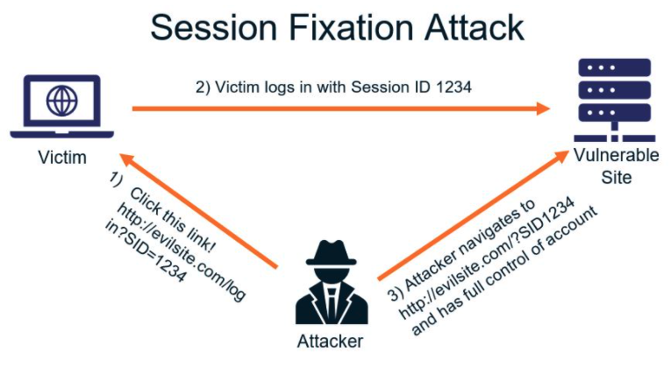
Reference
Notes:
https://securityboulevard.com/2020/11/the-ultimate-guide-to-session-hijacking-aka-cookie-hijacking/#:~:text=What%20is%20Session%20Hijacking%3F,re%20logged%20in%20and%20authenticated.

Slide 32
Conclusion
With the current growth and security risk associated with cloud, we must better equip ourselves with clear guidance and action plans
Knowing such risk is a good place to start and work towards all security gaps to reduce any conflicts between a cloud service provider and its clients
The service provider that has capability of IaaS, PaaS, SaaS, must owe its clients a robust security measures that leads to a trusting and long-lasting relationship
A web application access to a cloud service is just as important for its clients as detecting and fixing cyber hijacking
Both parties of cloud service must realize the importance of protecting information and must gather their attention to vulnerabilities that are at a finger tips of such fraudsters via internet

Slide 33
References
Luxner, T. (2021, March 15). Cloud computing trends: 2021 state of the cloud report. Flexera Blog. https://www.flexera.com/blog/cloud/cloud-computing-trends-2021-state-of-the-cloud-report/
Novet, J. (2018, February 14). The case for Apple to sell a version of iCloud for work. CNBC. https://www.cnbc.com/2018/02/11/apple-could-sell-icloud-for-the-enterprise-barclays-says.html
Vadapalli, P. (2021, February 5). 9 components of cloud computing architecture you should know about. upGrad blog. https://www.upgrad.com/blog/components-of-cloud-computing-architecture/
Hou, T. (2020, January 9). IaaS vs PaaS vs SaaS: What you need to know + examples (2018). The BigCommerce Blog. https://www.bigcommerce.com/blog/saas-vs-paas-vs-iaas/#the-key-differences-between-on-premise-saas-paas-iaas
Henderson, R. (2019, July 30). 8 IaaS cloud security challenges you should be aware of. Lastline. https://www.lastline.com/blog/8-iaas-cloud-security-challenges-you-should-be-aware-of/
Reddy, P., Bhupathi, V., & Sravan, C. (2017, April). Survey on Security Issues in Platform-as-a-Service Model. International Journal of Computer Science and Mobile Computing. https://ijcsmc.com/docs/papers/April2017/V6I4201799a12.pdf
Cox, P. (2009, December 11). Top threats in a PaaS cloud service and how to avoid them. SearchCloudComputing. https://searchcloudcomputing.techtarget.com/tip/Top-threats-in-a-PaaS-cloud-service-and-how-to-avoid-them
Cross site scripting vulnerability. (n.d.). Veracode. https://www.veracode.com/security/cross-site-scripting-vulnerability
Emmons, S. (2019, September 16). 7 key security risks to address when adopting SaaS applications. SonicWall. https://blog.sonicwall.com/en-us/2019/09/7-key-security-risks-to-address-when-adopting-saas-applications/
Dacosta, I., Chakradeo, S., Ahamad, M., & Traynor, P. (n.d.). One-Time Cookies: Preventing Session Hijacking Attacks with Stateless Authentication Tokens. Georgia Institute of Technology. https://smartech.gatech.edu/bitstream/handle/1853/42609/GT-CS-12-02.pdf
Vojtko, M. (2020, November 23). The Ultimate Guide to Session Hijacking aka Cookie Hijacking. SecurityBoulevard. https://securityboulevard.com/2020/11/the-ultimate-guide-to-session-hijacking-aka-cookie-hijacking/#:~:text=What%20is%20Session%20Hijacking%3F,re%20logged%20in%20and%20authenticated.
Eati, P. (n.d.). 10 most common web security vulnerabilities. Guru99. https://www.guru99.com/web-security-vulnerabilities.html
Conradi, M. (2014, August 29). Managing legal risks arising from cloud computing. Technology's Legal Edge. https://www.technologyslegaledge.com/2014/08/managing-legal-risks-arising-from-cloud-computing/
Lukan, D. (2015, November 20). Security vulnerabilities in cloud applications. Infosec Resources. https://resources.infosecinstitute.com/topic/security-vulnerabilities-in-cloud-applications/
MORROW, T. (2018, March 5). 12 risks, threats, & vulnerabilities in moving to the cloud. SEI Blog. https://insights.sei.cmu.edu/blog/12-risks-threats-vulnerabilities-in-moving-to-the-cloud/
7 cloud computing security vulnerabilities and what to do about them. (2020, July 13). Cypress Data Defence. https://towardsdatascience.com/7-cloud-computing-security-vulnerabilities-and-what-to-do-about-them-e061bbe0faee

